Slide 1
Research Design || Feature Selection POC
Atul Mishra | Data Scientist
Neha Sharma | Sr. ML Engineer

Slide 2
Objective
Problem Statement
TAO engineers spend extra efforts tuning an Auto Correlated model for relevant features.
Reason: In many cases relevant tag(s) having low correlation scores do not rank up in the feature list.
Methodology
Methodology to identify the logically related TAGS with the Target tag.
Select best features using a Statistical method that checks for significance along with linear relationship among the tags.
Current Approach
Analyse features associated with the target tag using Auto-Correlation Methodology.
Proposed Approach
To signify their relationship, we apply F-Test on the pool of features after correlation values are calculated.
Null Hypothesis for F-Test : There is no significant relationship between the FEATURE TAG and TARGET TAG.
Alternate Hypothesis: There is significant relationship between the FEATURE TAG and TARGET TAG.
KPI for estimating the F-Test: p_value
Higher the p_value, more evidence to support Null Hypothesis and hence we select all such features generating p_value less than 0.05 as a standard rule.

Slide 3
Methodology/Algorithm Explained SelectKBest
SelectKBest identifies the highly contributing features according to the k highest scores.
SelectKBest provides us the ability to execute Correlation and F-test simultaneously for the provided pool of features against the associated target tag.
SelectKBest works on avoiding the noise among the features by either eliminating such features from the feature list or by scoring them very low.
Revising the below points:
Correlation: Correlation is a statistic that measures the degree to which two variables move in relation to each other. It measures association, but doesn't show if x causes y or vice versa—or if the association is caused by a third factor.
F-Test: A Statistical Test to examine the significance of correlation calculated. Generally speaking, the test examines whether the samples for two distributions are originating from same population.
Scoring functions being used in SelectKBest:
f_regression: Contribution of Single feature examined against the Target feature.
mutual_info_regression: Estimating mutual information for a continuous target variable.
Ref:
https://scikit-learn.org/stable/modules/generated/sklearn.feature_selection.SelectKBest.html
Link is embedded for the respective scoring functions

Slide 4
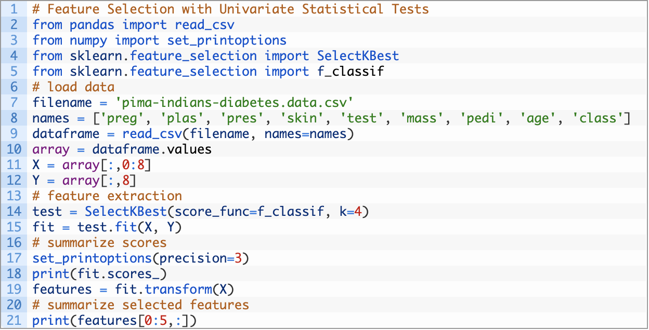
Implementation/Example
Since we are solving a regression problem, the scoring functions for regression are:
f_regression
mutual_info_regression
We fetch the TOP 20 features from the pool of 100 features extracted after correlation job from C3 tool for validation purpose.
The selected features have very low, verifying the significance of the linear relation between feature and target tag.

Slide 5
Approach of performing Experiments
TAG Name
CD6:602TC457.PV
CD6:602PC037.PV
CD6:608FC005.OP
CD6:602TT108.PV
MLO:021F064.MV
LS41243_AO4_OP
P4049_ID2_OP
MEOD:093P007.OP
98P503.MV
MLO:021F052.MV
114FICA034.MV
The final list of selected TAGS is mentioned in the table on which the experiments are to be performed.
Our objective for the experiments is:
Compare WB features with the SelectKBest returned features.
Proving that the AutoCorrelation methodology fails to pick up the features which are significant and hence are identified by the SelectKBest methodology.
We extract Top 20 features using SelectKBest from a pool of 100/120 features which includes WB and AutoCorrelated features.
The more the number of WB features obtained from SelectKBest, the stronger our methodology.

Slide 6
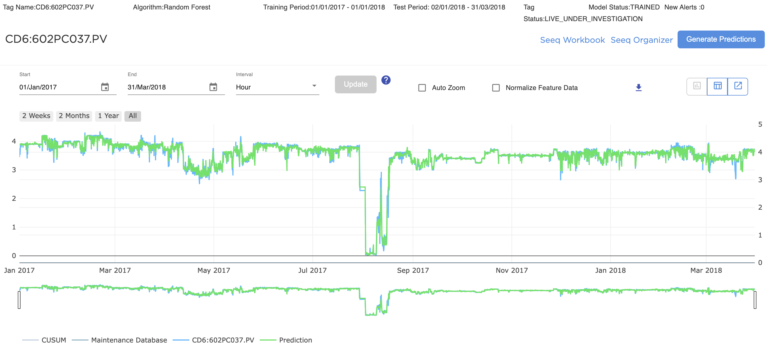
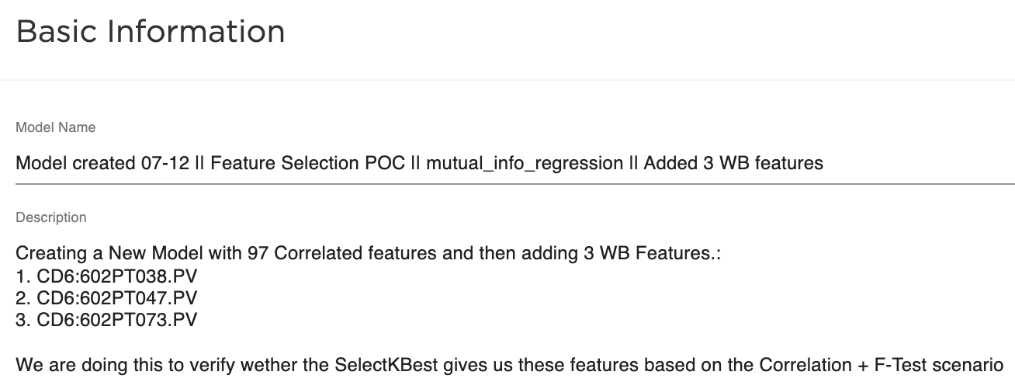
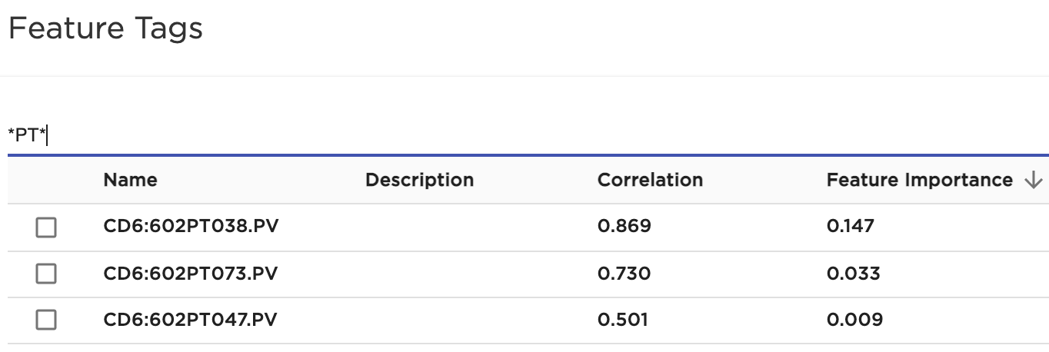
Experiment/Results
Tag Name | Metrics | WB Model Metrics |  | F_regression model metrics |  | Mutual_info_regression model metrics |  | Remarks
Verified ✅ |  | Insample | Outsample | Insample | Outsample | Insample | Outsample | 3 out of 3 WB Features matched. (Mutual-info)
CD6:602PC037.PV | R2 | 0.910 | -0.043 | 0.923 | -0.661 | 0.980 | 0.560
 | RMSE | 0.095 | 1.253 | 0.186 | 0.228 | 0.095 | 0.117
 | MAE | 0.066 | 0.665 | 0.127 | 0.169 | 0.058 | 0.073
Asset: Pernis
AC features

Slide 7
TAG Analysis
WB/LIVE Model Features
TAG Name | Correlation
CD6:602PT038.PV | 0.531
CD6:602PT047.PV | 0.140
CD6:602PT073.PV | 0.494
Auto Correlation Model Features
TAG Name | Correlation
CD6:602TT519.PV | 0.802
CD6:613PT002.PV | 0.747
CD6:602TT511.PV | 0.737
CD6:602TI222.PV | 0.731
CD6:602TT705.PV | 0.731
CD6:605TT077.PV | 0.711
CD6:602TT539.PV | 0.709
CD6:605TT078.PV | 0.699
CD6:606TT083.PV | 0.698
CD6:606TT072.PV | 0.698
SelectKBest Features
F_regression | Mutual_info_regression
Did not capture the relevant features | CD6:602PT038.PV
 | CD6:602PT047.PV
 | CD6:602PT073.PV
 | CD6:602T1422.PV
 | CD6:602T2422.PV
 | CD6:602TC071.PV
 | CD6:602TC075.PV
 | CD6:602TC422.PV
 | CD6:602TI350.PV
 | CD6:602TT071.PV
No WB features appeared in Auto-Corr features.
The SelectKBest is able to identify all the WB features.

Slide 8
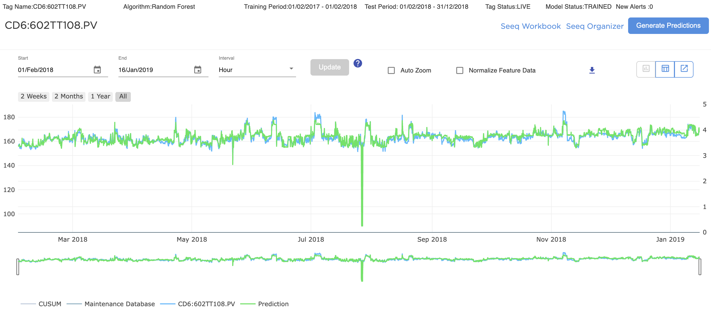
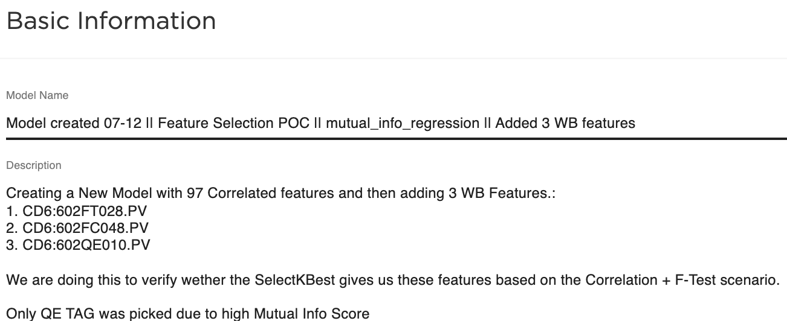
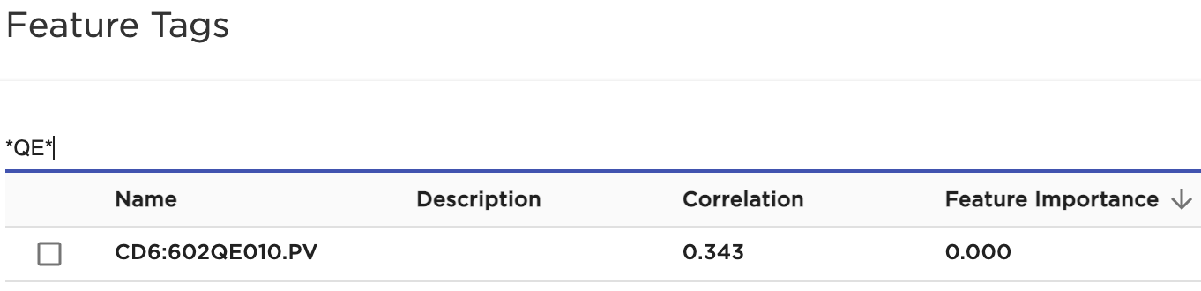
Experiment/Results
Tag Name | Metrics | WB Model Metrics |  | F_regression model metrics |  | Mutual_info_regression model metrics |  | Remarks
Verified ✅ |  | Insample | Outsample | Insample | Outsample | Insample | Outsample | 1 out of 3 WB features matched. The other 2 features had very low mutual_info_reg scores.
CD6:602TT108.PV | R2 | 0.992 | 0.801 | 0.993 | 0.843 | 0.993 | 0.421
 | RMSE | 2.107 | 2.114 | 1.993 | 1.877 | 2.021 | 3.604
 | MAE | 0.902 | 1.641 | 0.882 | 1.414 | 0.902 | 1.879
Asset: Pernis
AC features

Slide 9
TAG Analysis
SelectKBest Features
F_regression | Mutual_info_regression
Did not capture the relevant features | CD6:602TT446.PV
 | CD6:602TT436.PV
 | CD6:602TT437.PV
 | CD6:602TT448.PV
 | CD6:607TT141.PV
 | CD6:602TT428.PV
 | CD6:602TT364.PV
 | CD6:602TT466.PV
 | CD6:602TT422.PV
 | CD6:602QE010.PV
 | CD6:602TT386.PV
 | CD6:602TC422.PV
 | CD6:602TT459.PV
 | CD6:602TT481.PV
 | CD6:602TT447.PV
 | CD6:602TT467.PV
 | CD6:602TT473.PV
WB + Auto-Corr/LIVE Model Features
TAG Name | Correlation
CD6:602TT197.PV | 0.887
CD6:602TT428.PV | 0.956
CD6:602TT473.PV | 0.961
CD6:602FT028.PV | 0.548
CD6:602TT528.PV | 0.599
CD6:602TT376.PV | 0.866
CD6:602QE010.PV | 0.343
CD6:602T1004.PV | -0.133
CD6:602FC024.PV | -0.067
CD6:602FC048.PV | 0.323
Due to the 100 features selected, SelectKbest’s mutual information scoring function only identified the high contributing features.
A WB + Auto-Corr model is taken as KPI to compare.

Slide 10
Experiment/Results
WB/LIVE Model Features
TAG Name | Correlation
MLO:021F063.PV | 0.686
MLO:021FT063.PV | 0.686
MLO:021FT062.PV | 0.342
MLO:021F064.PV | 0.511
Auto Correlation Model Features
TAG Name | Correlation
MLO:021PR292.PV | -0.870
MLO:021P261.PV | -0.853
MLO:021T214.PV | 0.697
MLO:021PDY403A.PV | -0.645
MLO:021PDY403B.PV | -0.706
MLO:021T164.PV | 0.661
MLO:021PDR403.PV | -0.680
MLO:021FR125.PV | 0.692
MLO:021PDY403C.PV | -0.695
MLO:021F077.PV | 0.693
Tag Name
MLO:021F064.MV
Asset: Moerdijk
Validated by Santhip - TAO
SelectKBest Features
F_regression |  | Mutual_info_regression
MLO:021F007.PV | MLO:021F059.PV | MLO:021F056.PV | MLO:021T103.PV
MLO:021F011.PV | MLO:021F063.PV | MLO:021F060.PV | MLO:021T104.PV
MLO:021F015.PV | MLO:021FT007.PV | MLO:021F078.PV | MLO:021T121.PV
MLO:021F019.PV | MLO:021FT011.PV | MLO:021F098.PV | MLO:021T122.PV
MLO:021F051.PV | MLO:021FT015.PV | MLO:021F122.PV | MLO:021T162.PV
MLO:021F055.PV | MLO:021FT019.PV | MLO:021FR098.PV | MLO:021T164.PV
MLO:021FT051.PV | MLO:021P260.PV | MLO:021FT018.PV | MLO:041F021.PV
MLO:021FT055.PV | MLO:021P261.PV | MLO:021FT081A.PV | MLO:071P348.PV
MLO:021FT059.PV | MLO:021PR292.PV | MLO:021QR930.PV | MLO:071P427.PV
MLO:021FT063.PV | MLO:021T214.PV | MLO:021QR933.PV | MLO:071PC328.PV
Got 2 out of 4 WB Features because both FT063 and F063 were present in the feature pool.
All the RED and GREEN marked features are directly/indirectly related to the prediction TARGET.
Feedback from TAO.
Tags indirectly related to Prediction target and directly related to WB features
AC Features
No WB features appeared in Auto Corr features.

Slide 11
Experiment/Results
WB/LIVE Model Features
TAG Name | Correlation
MEOD:093P006.PV | -0.306
MEOD:093F082.PV | 0.274
MEOD:093FT082.PV | 0.274
MEOD:093PT007.PV | -0.103
MEOD:093P007.PV | -0.104
Auto Correlation Model Features
TAG Name | Correlation
MEOD:093TS124.PV | 0.816
MEOD:093TR330.PV | 0.813
MEOD:093TR327.PV | 0.799
MEOD:093TR326.PV | 0.794
MEOD:093TR325.PV | 0.794
MEOD:093TR324.PV | 0.790
MEOD:093TC236.PV | 0.802
MEOD:093T170.PV | 0.836
MEOD:093T139.PV | 0.831
MEOD:093T138.PV | 0.834
Tag Name
MEOD:093P007.OP
Asset: Moerdijk
Validated by Santhip - TAO
SelectKBest Features
F_regression |  | Mutual_info_regression
MEOD:093F025.PV | MEOD:093T170.PV | MEOD:093P007.PV | MEOD:093TR324.PV
MEOD:093FR205.PV | MEOD:093TC236.PV | MEOD:093PT007.PV | MEOD:093TR325.PV
MEOD:093FT027.PV | MEOD:093TR325.PV | MEOD:093T023.PV | MEOD:093TR326.PV
MEOD:093L009.PV | MEOD:093TR326.PV | MEOD:093T025.PV | MEOD:093TR327.PV
MEOD:093P005.PV | MEOD:093TR327.PV | MEOD:093T064.PV | MEOD:093TR328.PV
MEOD:093P014.PV | MEOD:093TR330.PV | MEOD:093T072.PV | MEOD:093TR329.PV
MEOD:093PR129.PV | MEOD:093TR331.PV | MEOD:093T073.PV | MEOD:093TR330.PV
MEOD:093T120.PV | MEOD:093TS124.PV | MEOD:093T170.PV | MEOD:093TR331.PV
MEOD:093T138.PV | MEOD:093T033.PV | MEOD:093TR041.pv | MEOD:093TR332.PV
MEOD:093T139.PV | MEOD:093T119.PV | MEOD:093TR323.PV | MEOD:093TR333.PV
Got almost 2 WB features out of 5 whereas the AutoCorrelation Model failed to get even one WB feature.
AC Features
The top 20 features does not contain even one single WB feature.
Tags indirectly related to Prediction target and directly related to WB features

Slide 12
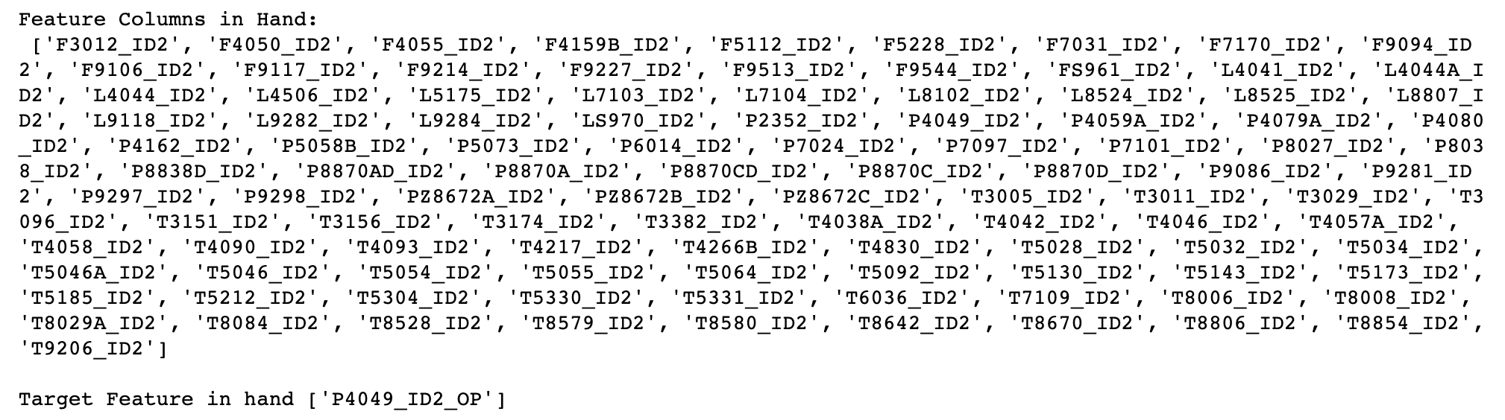
Experiment/Results
WB/LIVE Model Features
TAG Name | Correlation
T4042_ID2 | -0.125
L4041_ID2 | -0.218
L4044A_ID2 | -0.266
T4046_ID2 | -0.039
F4050_ID2 | -0.085
L4506_ID2 | -0.216
P4049_ID2 | -0.232
L4044_ID2 | -0.230
Auto Correlation Model Features
TAG Name | Correlation
L7104_ID2 | 0.361
F3012_ID2 | -0.357
F9544_ID2 | -0.387
T4038A_ID2 | 0.354
P9281_ID2 | -0.333
P5058B_ID2 | -0.323
P9297_ID2 | -0.334
L8524_ID2 | -0.402
T5185_ID2 | -0.319
P9298_ID2 | -0.399
P5073_ID2 | -0.369
F9117_ID2 | 0.369
T8528_ID2 | -0.374
L8525_ID2 | -0.392
T3011_ID2 | -0.328
T8806_ID2 | -0.352
T5173_ID2 | -0.366
Tag Name
P4049_ID2_OP
Asset: Geismar
Validated by Thriambak - TAO

Slide 13
SelectKBest Features
F_regression |  | Mutual_info_regression
F7170_ID2 | T5130_ID2 | F7170_ID2 | P9298_ID2
L7104_ID2 | T5173_ID2 | L4041_ID2 | T3096_ID2
L8524_ID2 | T5185_ID2 | L4044A_ID2 | T4042_ID2
L8525_ID2 | T5212_ID2 | L4044_ID2 | T5130_ID2
L8807_ID2 | T5331_ID2 | L4506_ID2 | T5185_ID2
L9284_ID2 | T8006_ID2 | L9118_ID2 | T5212_ID2
P5073_ID2 | T8008_ID2 | L9284_ID2 | T8006_ID2
P9281_ID2 | T8528_ID2 | P5058B_ID2 | T8008_ID2
P9298_ID2 | T8806_ID2 | P8838D_ID2 | T8528_ID2
T4038A_ID2 | T9206_ID2 | P9086_ID2 | T9206_ID2
Tag Name
P4049_ID2_OP
Asset: Geismar
Validated by Thriambak - TAO
Got 5 out of 8 WB Features.
The top 20 features does not contain even one single WB feature.
Red Marked features are the WB Features.
Green Marked features are the features in direct relation with TARGET TAG.

Slide 14
Experiment/Results
WB/LIVE Model Features
TAG Name | Correlation
98F501.PV | -0.807
98F503.PV | -0.806
98F524.PV | -0.807
98P503.PV | -0.438
98F520.PV | -0.810
98F521.PV | -0.806
Auto Correlation Model Features
TAG Name | Correlation
98F520.PV | -0.841
98F524.PV | -0.865
98P510.PV | -0.821
98F501.PV | -0.836
98P541.PV | -0.786
98F522.PV | -0.803
98F503.PV | -0.833
98F525.PV | -0.830
98F517.PV | -0.737
98P711.PV | -0.798
Tag Name
98P503.MV
Asset: Bukom
Validated by Vijaya - TAO
SelectKBest Features
F_regression |  | Mutual_info_regression
98F501.PV | 98P509.PV | 98F501.PV | 98P508.PV
98F503.PV | 98P510.PV | 98F520.PV | 98P509.PV
98F517.PV | 98P524.PV | 98F522.PV | 98P510.PV
98F520.PV | 98P711.PV | 98F525.PV | 98P524.PV
98F521.PV | 98T682.PV | 98F528.PV | 98P711.PV
98F522.PV | 98T683.PV | 98F529.PV | 98T715.PV
98F523.PV | 98T684.PV | 98L576.PV | 98T717.PV
98F524.PV | 98T685.PV | 98P502.PV | 98T718B.PV
98F525.PV | 98T686.PV | 98P505.PV | 98T719B.PV
98P505.PV | 98T687.PV | 98P506.PV | 98T723.PV
Got 5 out of 6 WB Features.
All the RED and GREEN marked features are directly/indirectly related to the prediction TARGET.
Feedback from TAO.
AC Features
Top 20 features had only 3 WB features

Slide 15
Experiment/Results
WB/LIVE Model Features
TAG Name | Correlation
114FY034.PV | 0.984
114FIC035.PV | 0.662
112FIA001.PV | -0.732
116TICA004.PV | -0.676
114FICA034.PV | 0.979
Auto Correlation Model Features
TAG Name | Correlation
114FY034.PV | 0.882
114PY028.PV | 0.810
116XT206A.PV | 0.809
114PDI024.PV | 0.821
114PDI006.PV | 0.810
114FICA039.PV | 0.810
114FICA038.PV | 0.814
114FIC035.PV | 0.854
114FI039.PV | 0.810
113FI028.PV | 0.809
Tag Name
114FICA034.MV
Asset: Bukom
Validated by Vijaya - TAO
SelectKBest Features
F_regression |  | Mutual_info_regression
103TI017.PV | 103TZA023.PV | 103PI512.PV | 103TIA212.PV
103TI018.PV | 111TI427.PV | 103PI513.PV | 103TIA305.PV
103TI029.PV | 111TIA201.PV | 103PI533.PV | 103TIA412.PV
103TI030.PV | 112FIA001.PV | 103PI534.PV | 103TIA505.PV
103TIA112.PV | 113TI065.PV | 103TI014.PV | 103TIA605.PV
103TIA212.PV | 113TIA063.PV | 103TI016.PV | 104PIA007.PV
103TIA312.PV | 114FIC035.PV | 103TI017.PV | 104PT008A.PV
103TIA412.PV | 114FICA034.PV | 103TI108.PV | 104PT008B.PV
103TIA512.PV | 116LICA006.PV | 103TIA105.PV | 111TI427.PV
103TIA612.PV | 116TICA004.PV | 103TIA205.PV | 114FICA034.PV
Got 2 WB features out of 5.
The returned features are NOISY features and hence they are ranked low.

Slide 16
Experiment/Results
WB/LIVE Model Features
TAG Name | Correlation
MLO:021FT051.PV | 0.542
MLO:021F051.PV | 0.542
MLO:021P021.PV | 0.382
MLO:021FT050.PV | 0.280
MLO:021F052.PV | 0.298
Auto Correlation Model Features
TAG Name | Correlation
MLO:021T214.PV | 0.567
MLO:021T164.PV | 0.613
MLO:021PR292.PV | -0.771
MLO:021P261.PV | -0.770
MLO:021F064.SV | 0.566
MLO:021F064.PV | 0.565
MLO:021F056.PV | 0.654
MLO:021F020.PV | 0.564
MLO:021F012.SV | 0.626
MLO:021F012.PV | 0.626
Tag Name
MLO:021F052.MV
Asset: Moerdijk
SelectKBest Features
F_regression |  | Mutual_info_regression
MLO:020L011.PV | MLO:021P021.PV | MLO:021F052.PV | MLO:021FT081A.PV
MLO:021F012.PV | MLO:021P261.PV | MLO:021F056.PV | MLO:021P021.PV
MLO:021F020.PV | MLO:021PR292.PV | MLO:021F078.PV | MLO:021T103.PV
MLO:021F056.PV | MLO:030FR463.PV | MLO:021F098.PV | MLO:021T104.PV
MLO:021F078.PV | MLO:030T389.PV | MLO:021FR098.PV | MLO:021T162.PV
MLO:021FT010.PV | MLO:040L043.PV | MLO:021FT010.PV | MLO:021T164.PV
MLO:021FT018.PV | MLO:040PR652.PV | MLO:021FT014.PV | MLO:041F021.PV
MLO:021FT014.PV | MLO:041F014.PVU | MLO:021FT018.PV | MLO:071P417.PV
MLO:021FT054.PV | MLO:041F612.PV | MLO:021FT050.PV | MLO:071P427.PV
MLO:021FT062.PV | MLO:041F614.PV | MLO:021FT054.PV | MLO:021F122.PV
Got 3 WB features out of 5 whereas the AutoCorrelation Model failed to get even one WB feature.

Slide 17
Experiment/Results
WB/LIVE Model Features
TAG Name | Correlation
FS41247_AO4 | 0.886
PS41236D_AO4 | -0.145
LS41233_AO4 | 0.157
TS41193_AO4 | -0.668
LS41243_AO4 | 0.159
TS41239_AO4 | -0.229
PS41237_AO4 | 0.674
TS41240_AO4 | -0.150
TS41211_AO4 | -0.131
PS41236_AO4 | 0.011
TS41241_AO4 | -0.158
TS41250_AO4 | 0.155
TS41238_AO4 | 0.029
LS41203_AO4 | -0.078
TS41235_AO4 | 0.341
LS41251_AO4 | 0.055
Auto Correlation Model Features
TAG Name | Correlation
FS41277_AO4 | 0.939
FS40041_AO4 | 0.864
FS41009_AO4 | 0.926
TS41085Y_AO4 | 0.892
FS41200_AO4 | 0.853
TS41073Y_AO4 | 0.891
FS41248_AO4 | 0.883
FS41306_AO4 | 0.867
TS41264_AO4 | -0.855
FS41247_AO4 | 0.886
FS42421_AO4 | 0.853
FS42100_AO4 | 0.855
FS41255_AO4 | 0.938
TS41101Y_AO4 | 0.899
FS42221_AO4 | 0.856
FS41162_AO4 | 0.883
FS41218_AO4 | 0.898
Tag Name
LS41243_AO4_OP
Asset: Geismar

Slide 18
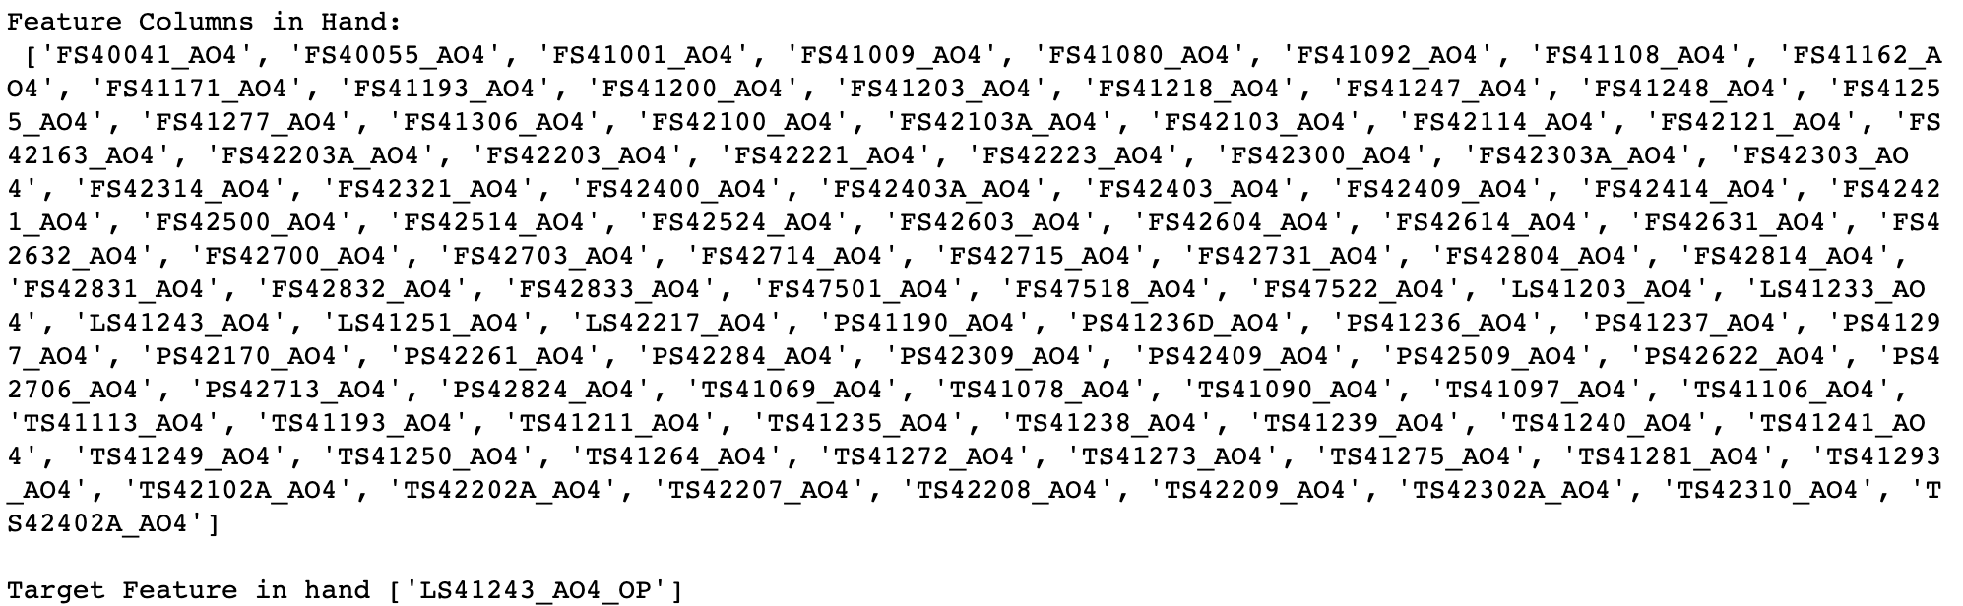
SelectKBest Features
F_regression |  | Mutual_info_regression
FS41001_AO4 | FS41306_AO4 | FS40041_AO4 | FS41306_AO4
FS41009_AO4 | FS42100_AO4 | FS41001_AO4 | FS42100_AO4
FS41092_AO4 | FS42421_AO4 | FS41009_AO4 | FS42303A_AO4
FS41162_AO4 | FS42604_AO4 | FS41162_AO4 | FS42421_AO4
FS41193_AO4 | FS42631_AO4 | FS41200_AO4 | FS42603_AO4
FS41203_AO4 | FS42632_AO4 | FS41203_AO4 | FS42604_AO4
FS41218_AO4 | FS42715_AO4 | FS41247_AO4 | FS42632_AO4
FS41247_AO4 | FS42731_AO4 | FS41248_AO4 | FS42832_AO4
FS41255_AO4 | FS42804_AO4 | FS41255_AO4 | PS42509_AO4
FS41277_AO4 | TS41090_AO4 | FS41277_AO4 | TS41264_AO4
Tag Name
LS41243_AO4_OP
Majority of WB features are missing due to bounded Feature Space which does not contain LEVEL Feature TAGS.
This TAG shows high dependability among feature TAGS.
Methodology needs to be executed on more number of feature tags.

Slide 19
Pros/Cons of the SelectKBest Methodology
PROS:
The Methodology can pick up the unseen relationships between the features and among the feature-target TAG.
The two scoring functions used f_regression and mutual_info_regression, pick up the univariate and multivariate relationship respectively and hence both play important role depending upon the nature of the TAG.
F-Test helps in identifying the contributing features instead of just ranking the features based upon the calculated correlation.
CONS:
The Methodology needs to be executed on the whole pool of feature tags associated to a TARGET TAG.
Executing SelectKBest with mutual_info_regression scoring function is more extensive that running normal AutoCorrelation job.

Slide 20
Questions and Answers

Slide 21
Technical Understanding
F-Test
F-Test is a statistical test used to compare between models and check if the difference is significant between the models.
F-Test does a hypothesis testing model X and Y where X is a model created by just a constant and Y is the model created by a constant and a feature.
The least square errors in both the models are compared and checks if the difference in errors between model X and Y are significant or introduced by chance.
F-Test is useful in feature selection as we get to know the significance of each feature in improving the model.
Mutual Information
Mutual Information between two variables measure the dependence of one variable to another. If X and Y are two variables, and
If X and Y are independent, then no information about Y can be obtained by knowing X or vice-versa. Hence their mutual information is 0.
If X is a deterministic function of y, then we can determine X from Y and Y from X with mutual information 1.
When we have Y = f(X,Z,M,N), then 0 < mutual information < 1.
We can select our features from feature space by ranking their mutual information with the target variable.
Advantage of using Mutual Information over F-Test is, it does well with he non-linear relationship between feature and the target variable.

Slide 23
Experiment/Results
Auto-Corr Model Features
TAG Name | Correlation
1C1101_1:111F005B.PNT | 0.868
1E1406_1:114FR002.PNT | 0.866
1GT1401_3:114FT010.PNT | 0.872
1GT1401_1:114FI011.PNT | 0.870
1GT1401_1:114F011.PNT | 0.872
1V1203_1:112F004.PNT | 0.862
1V1101_1:111F003.PNT | 0.854
1E1406_1:114FT002B.PNT | 0.864
1E1405_1:114PD011.PNT | 0.856
1C1101_1:111F005.PNT | 0.866
Tag Name
1E1402_3:114LC004.OUT NLNG Site
SelectKBest Features
F_regression | Mutual_info_regression
1C1101_1:111F005.PNT | 1C1101_1:111F005.PNT
1C1101_1:111F005B.PNT | 1E1405_1:114PD011.PNT
1E1405_1:114PD011.PNT | 1F4110_1:141F052.PNT
1E1406_1:114FR002.PNT | 1F4110_1:141F053.PNT
1E1406_1:114FT002B.PNT | 1F4110_1:141F056.PNT
1GT1401_1:114F011.PNT | 1P4101_2:141FT045.PNT
1GT1401_1:114FI011.PNT | 1S1201_1:112PD005.PNT
1GT1401_3:114FT010.PNT | 1V1101_1:111F003.PNT
1V1101_1:111F003B.PNT | 1V1101_1:111F003B.PNT
1V1203_1:112F004.PNT | 1V1203_1:112F004.PNT
The feature 1E1405_1:114PD011.PNT is getting higher importance when F_regression or AutoCorrelation models are created, but the same importance is distributed among other features when Mutual_info_regression features are used, without declining performance.

Slide 24
Experiment/Results
Auto Correlation Model Features
TAG Name | Correlation
MLO:030FT118.PV | 0.843
MLO:030FC118.PV | 0.843
MLO:030F014.PV | 0.716
MLO:030L070.PV | -0.746
MLO:071L009.PV | 0.737
Tag Name
MLO:030L104.OP
Asset: Moerdijk
SelectKBest Features
F_regression |  | Mutual_info_regression
MLO:030F014.PV | MLO:030T288.PV | MLO:017P052.PV | MLO:030T288.PV
MLO:030FC118.PV | MLO:030T602.PV | MLO:018P057.PV | MLO:030T296.PV
MLO:030FT118.PV | MLO:030T905.PV | MLO:018P058.PV | MLO:030T330.PV
MLO:030L070.PV | MLO:030TR871.PV | MLO:018P059.PV | MLO:030T602.PV
MLO:030L607.PV | MLO:040F633.PV | MLO:030F206.PV | MLO:030TR871.PV
MLO:030LR207B.PV | MLO:040T331.PV | MLO:030FT206.PV | MLO:040P164.PV
MLO:030LR607.PV | MLO:069LR002.PV | MLO:030L070.PV | MLO:040P904.PV
MLO:030P606.PV | MLO:071P049.PV | MLO:030L606.PV | MLO:041L008.PV
MLO:030P624.PV | MLO:071PR010.PV | MLO:030P624.PV | MLO:071P049.PV
MLO:030T229.PV |  | MLO:030PR679.PV | MLO:071T006.PV
WB/LIVE Model Features
TAG Name | Correlation
MLO:030FT118.PV | 0.843
MLO:030FC118.PV | 0.843
MLO:030FT090.PV | -0.127
MLO:030F089.PV | -0.256
MLO:030FT089.PV | -0.256
MLO:030F120.PV | 0.166
MLO:030FS090.PV | 0.531
MLO:030F090.PV | 0.578

Slide 25
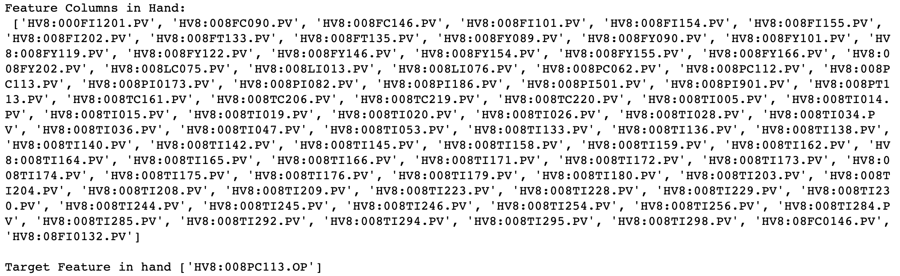
Experiment/Results
WB/LIVE Model Features
TAG Name | Correlation
HV8:008TC161.PV | -0.546
HV8:008TI036.PV | -0.618
HV8:008FI155.PV | -0.532
HV8:008FY155.PV | -0.401
HV8:008FI154.PV | -0.349
HV8:008FY154.PV | -0.349
HV8:008LC075.PV | 0.087
HV8:008TI230.PV | -0.584
HV8:008PT113.PV | -0.118
HV8:008PC112.PV | -0.150
HV8:008PC113.PV | -0.118
HV8:008PI0173.PV | -0.557
HV8:008TI292.PV | -0.560
SelectKBest Features
F_regression | Mutual_info_regression
HV8:008FI202.PV | HV8:008FC146.PV
HV8:008FY202.PV | HV8:008FY146.PV
HV8:008PI082.PV | HV8:008PI186.PV
HV8:008PI186.PV | HV8:008TI036.PV
HV8:008TI036.PV | HV8:008TI047.PV
HV8:008TI175.PV | HV8:008TI142.PV
HV8:008TI176.PV | HV8:008TI230.PV
HV8:008TI230.PV | HV8:008TI244.PV
HV8:008TI244.PV | HV8:008TI245.PV
HV8:008TI245.PV | HV8:08FC0146.PV
Tag Name
HV8:008PC113.OP
Asset: Pernis
Auto Correlation Model Features
TAG Name | Correlation
HV8:08LI0045.PV | 0.572
HV8:008TT190.PV | -0.589
HV8:008TI292.PV | -0.588
HV8:008TI230.PV | -0.670
HV8:008TI192.PV | -0.594
HV8:008TI036.PV | -0.667
HV8:008PI0173.PV | -0.637
HV8:008PI0119.PV | -0.601
HV8:008PC116.PV | -0.625
HV8:008LI076.PV | -0.581
With current exact Exclusion rules, fetched 87 TAGS overall out of which SelectKBest was able to pickup 2 WB Tags

Slide 26
Experiment/Results
WB/LIVE Model Features
TAG Name | Correlation
HDS5:86PT122.PV | 0.855
HDS5:86FC014.PV | 0.933
Auto Correlation Model Features
TAG Name | Correlation
HDS5:86PT122.PV | 0.871
HDS5:86PT121.PV | 0.838
HDS5:86PI124.PV | 0.800
HDS5:86PI106.PV | 0.800
HDS5:86FY011.PV | 0.877
HDS5:86FC015.PV | 0.869
HDS5:86FC014.PV | 0.881
HDS5:86FC006.PV | 0.849
HDS5:86FC003.PV | 0.901
HDS5:84FY005.PV | 0.806
Tag Name
HDS5:86FC014.OP
SelectKBest Features
F_regression | Mutual_info_regression
HDS5:86FC003.PV | HDS5:86FC003.PV
HDS5:86FC006.PV | HDS5:86FC014.PV
HDS5:86FC014.PV | HDS5:86FC015.PV
HDS5:86FC015.PV | HDS5:86FI102.PV
HDS5:86FY011.PV | HDS5:86PC107.PV
HDS5:86PC107.PV | HDS5:86PI106.PV
HDS5:86PI106.PV | HDS5:86PI124.PV
HDS5:86PI124.PV | HDS5:86PT110.PV
HDS5:86PT121.PV | HDS5:86PT117.PV
HDS5:86PT122.PV | HDS5:86PT122.PV
With current exact Exclusion rules, fetched 99 TAGS overall out of which SelectKBest was able to pickup all WB Tags which are creating relationship among themselves and with the Target Tag also.
One quick thing to notice is that FC014 is contributing more towards the Target feature and hence is ranked above PT122.

Slide 27
Experiment/Results
Tag Name | Metrics | WB Model Metrics |  | F_regression model metrics |  | Mutual_info_regression model metrics |  | Remarks
Verified ✅ |  | Insample | Outsample | Insample | Outsample | Insample | Outsample | 7 out of 10 WB/LIVE features matched.
CD6:602TC457.PV | R2 | 0.986 | 0.898 | 0.991 | 0.916 | 0.931 | 0.906
 | RMSE | 2.784 | 0.862 | 2.285 | 0.781 | 6.264 | 0.827
 | MAE | 1.092 | 0.604 | 0.928 | 0.494 | 0.818 | 0.226
Asset: Pernis
WB/LIVE Features
CD6:602TC452.PV | CD6:602TT125.PV | CD6:602TC453.PV
CD6:602TC451.PV | CD6:602TC450.PV | CD6:602TC454.PV
CD6:602TC455.PV | CD6:602FC360.PV | CD6:602TT445.PV
CD6:602FC367.PV
Auto Correlated Features
CD6:602TT457.PV | CD6:602TC124.PV | CD6:602TT124.PV
CD6:602TT452.PV | CD6:602TC452.PV | CD6:602TT125.PV
CD6:602TT455.PV
SelectKBest Features
CD6:602TC124.PV | CD6:602TC454.PV | CD6:602TT450.PV
CD6:602TC124.SP | CD6:602TC455.PV | CD6:602TT451.PV
CD6:602TC450.PV | CD6:602TC456.PV | CD6:602TT452.PV
CD6:602TC451.PV | CD6:602TI126.PV | CD6:602TT453.PV
CD6:602TC452.PV | CD6:602TT124.PV | CD6:602TT455.PV
CD6:602TC453.PV | CD6:602TT125.PV | CD6:602TT456.PV
CD6:602TT457.PV | CD6:602TT481.PV

Slide 28
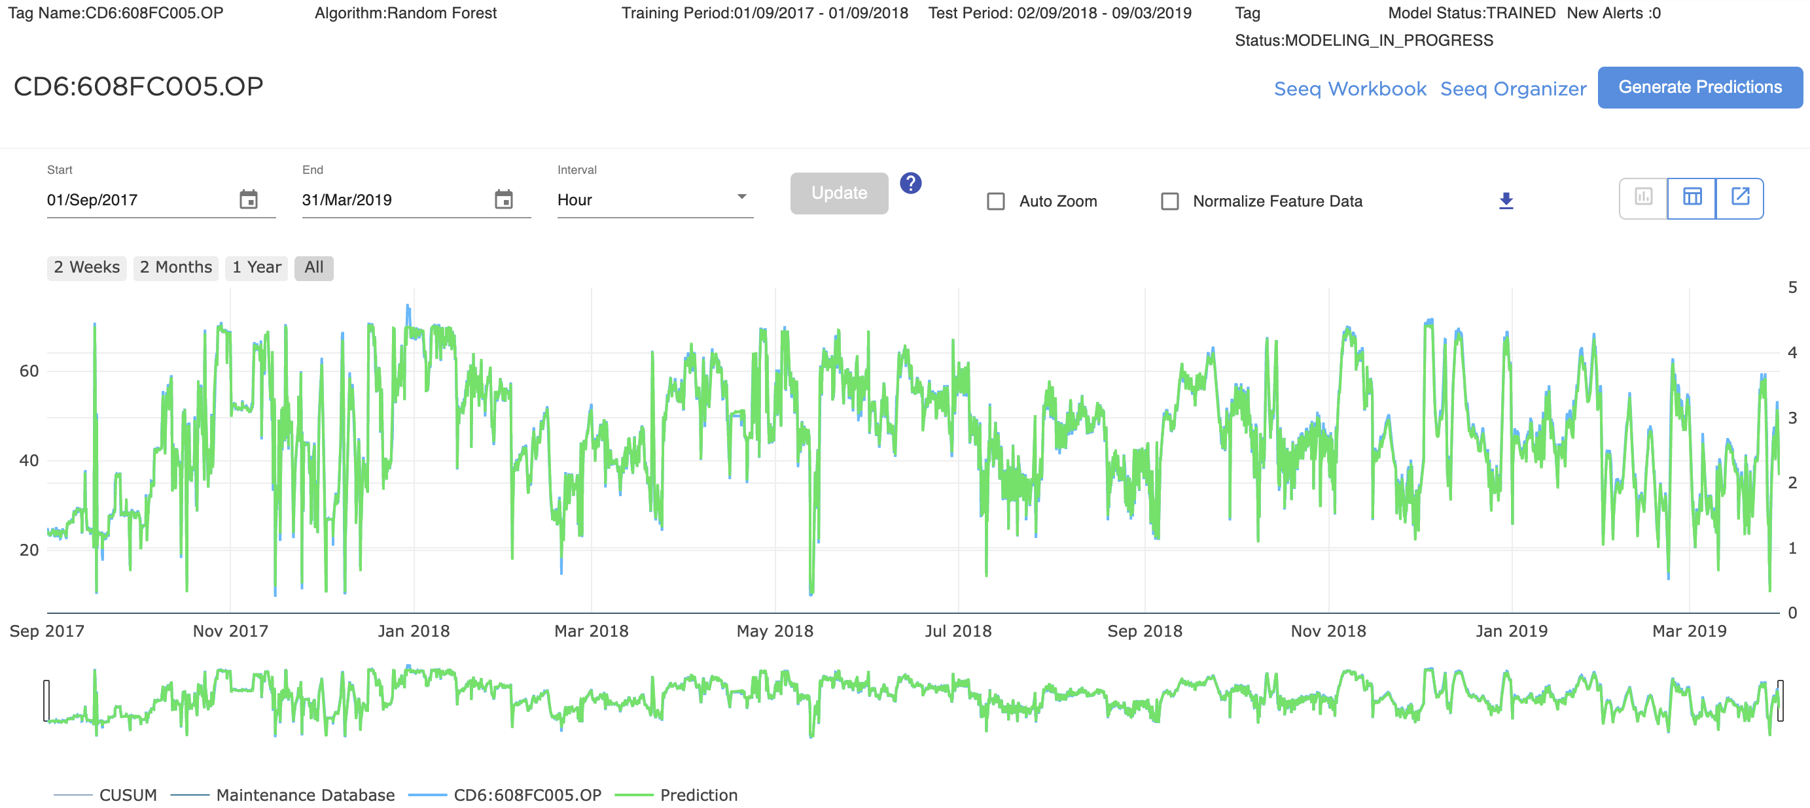
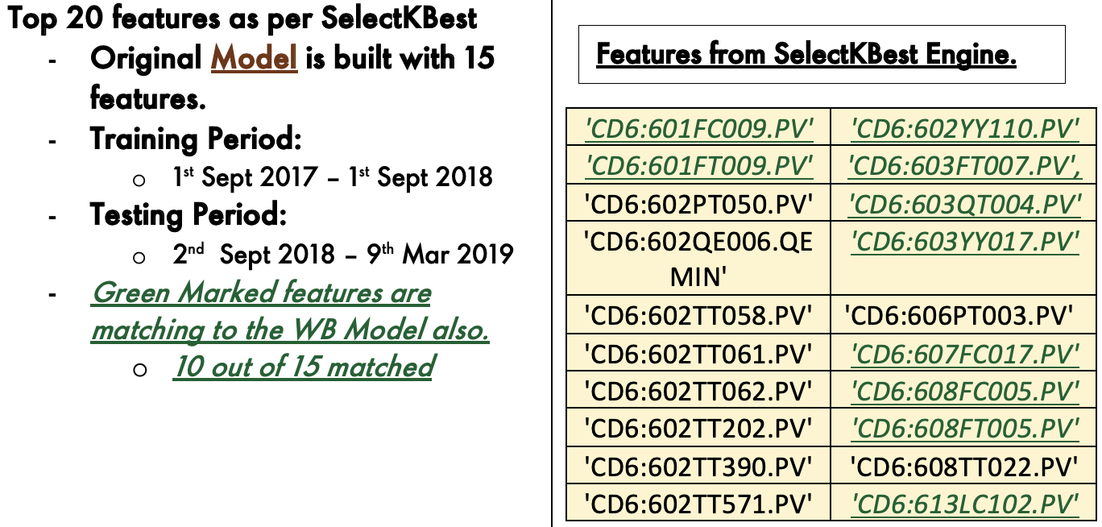
Experiment/Results
Tag Name | Metrics | WB Model Metrics |  | F_regression model metrics |  | Mutual_info_regression model metrics |  | Remarks
Verified ✅ |  | Insample | Outsample | Insample | Outsample | Insample | Outsample | 10 out of 15 WB Model features matched. (F_regression)
CD6:608FC005.OP | R2 | 0.993 | 0.989 | 0.998 | 0.994 | 0.999 | 0.993
 | RMSE | 1.097 | 1.196 | 0.510 | 0.854 | 0.486 | 0.925
 | MAE | 0.875 | 0.957 | 0.375 | 0.706 | 0.357 | 0.757
Asset: Pernis

Slide 29
Experiment/Results
WB/LIVE Model Features
TAG Name | Correlation
GP3:074FY011.PV | 0.830
GP3:074PC611.PV | -0.475
GP3:074PC001.PV | 0.302
GP3:074PI005.PV | -0.169
GP3:074TI012.PV | -0.111
Tag Name
GP3:074LC003.OP
SelectKBest Features
F_regression | Mutual_info_regression
Auto Correlation Model Features
TAG Name | Correlation

Slide 30
Experiment/Results
WB/LIVE Model Features
TAG Name | Correlation
Tag Name
CVP:77FC005.OUT
SelectKBest Features
F_regression | Mutual_info_regression

Slide 31
Experiment/Results
WB/LIVE Model Features
TAG Name | Correlation
Tag Name
C4TR:040PC431.OP
SelectKBest Features
F_regression | Mutual_info_regression

